Slide 1
《生物医学统计学》讨论课
齐光耀
gyqi@ion.ac.cn
2019年3月27日

Slide 2
Outline
Basic statistics concepts
Statistical Features
Over and Under Sampling
Dimensionality Reduction
Class discussion

Slide 3
Basic statistics concepts
Statistical Features
Quantile
A basic box plot

Slide 4
Basic statistics concepts
Over and Under Sampling are techniques used for classification problems.
Notes:
Under-representation of one class in the outcome (dependent) variable.
Under-representation of a class in one or more important predictor variables.

Slide 5
Basic statistics concepts
Dimensionality Reduction
Space required to store the data is reduced as the number of dimensions comes down
Less dimensions lead to less computation/training time
Some algorithms do not perform well when we have a large dimensions. So reducing these dimensions needs to happen for the algorithm to be useful
It takes care of multicollinearity by removing redundant features.
Visualization.
e.g. PCA

Slide 6
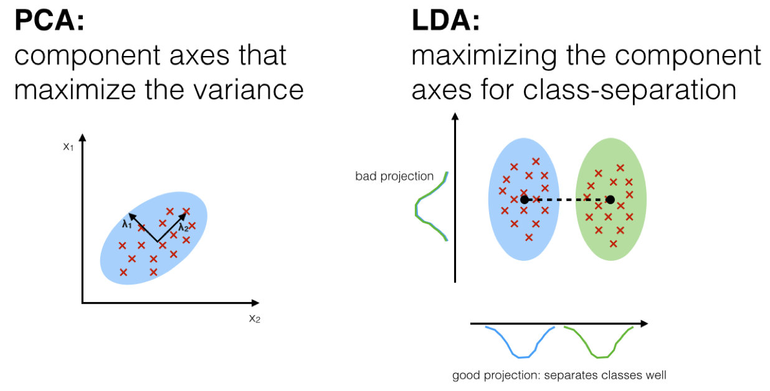
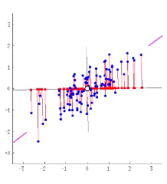
Basic statistics concepts
Principal component analysis (PCA) is a technique used to emphasize variation and bring out strong patterns in a dataset. It's often used to make data easy to explore and visualize.
Component axes that maximize the variance.
A step-by-step instruction:
Organize data as an m × n matrix, where m is the number of measurement types and n is the number of samples.
Subtract off the mean for each measurement type.
Calculate the SVD or the eigenvectors of the covariance.
Notes:
When should I use PCA?
Do you want to reduce the number of variables, but aren’t able to identify variables to completely remove from consideration?
Do you want to ensure your variables are independent of one another?
Are you comfortable making your independent variables less interpretable?

Slide 7
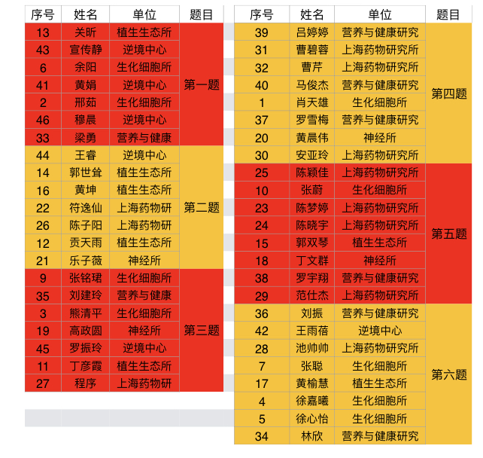
Class discussion
10min

Slide 8
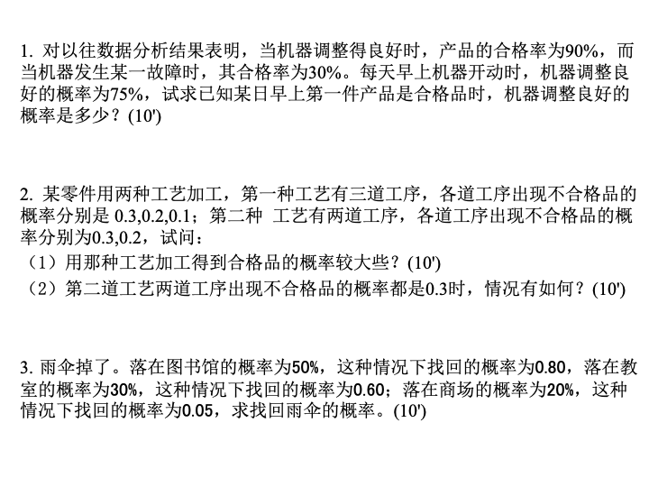

Slide 9
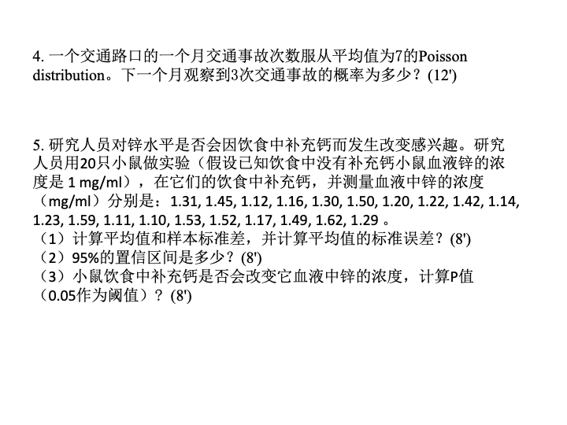

Slide 10
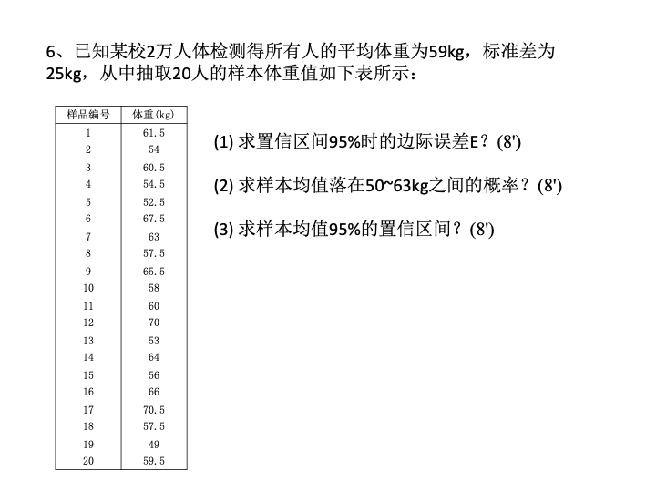

Slide 11
Basic statistics concepts
Probability Distributions
Common Probability Distributions. Uniform (left), Normal (middle), Poisson (right)

Slide 12
Basic statistics concepts
Bayesian Statistics VS. Frequency Statistics

